Slide 1
TEAM4OIES Online International EVAR System PRESENTATION Spring 2015
At most 10 slides; It should include the Database as well.

Slide 2
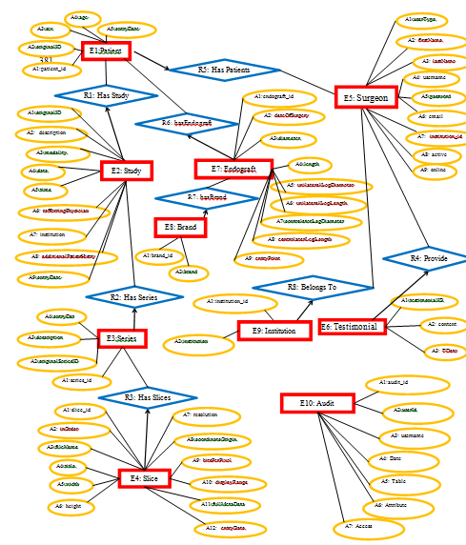
TEAM4OIES Online International EVAR System DATABASE BACK END
Added by VH; Please discuss DB first
Please place these as dividers
# of Es: 10
# of Rs: 8
# of Vs: 1
# of Ts: 1
# of Ds: 18
# of Cs: 12

Slide 3
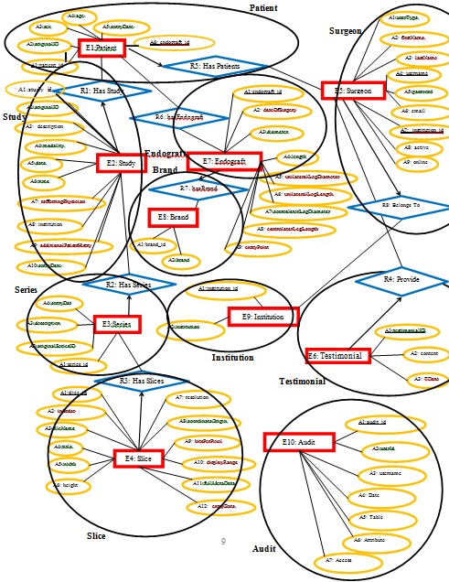
TEAM4OIES Online International EVAR System DATABASE BACK END
Relations…?
1 to 1, Many to 1…?
Picture of ERD…?
What Data (analysis):
# of Es: 10
# of Rs: 8
HOW Data (design):
# of Relations: 10

Slide 4
TEAM4OIES Online International EVAR System FRONT END
Added by VH;
Please place these as dividers

